Slide 1
MARKETING WEB ANALYTICS & INSIGHTS PROJECT
GROUP 4: Nimisha Reddy Pocharam, Raveen Dham, Urvi Zope, Ankita Shinde, Hitarth Patel, Samved Sangle

Slide 2
Company Overview
Established in 2005 in Brooklyn, NY; a global online marketplace for unique and creative goods.
Connects millions to make, sell, buy, and collect unique items, with a focus on personal and human commerce.
Driven by a mission to reimagine commerce in ways that build a more fulfilling and lasting world, targeting zero emissions by 2030.
Hosts over 92 million active buyers and 7 million active sellers, supporting small businesses and independent creators.

Slide 3
Business Objectives
To amplify market presence and user acquisition by executing targeted marketing initiatives aimed at increasing the count of active buyers and sellers, serving as a direct measure of market share growth.
To elevate conversion rates and nurture customer loyalty, deploying enhanced site features and personalized experiences aimed at lifting key metrics such as conversion rate, customer lifetime value, and repeat purchase frequency.

Slide 4
Key Performance Indicators (KPIs) and Metrics
KPI 1: User Acquisition
a. New Visitors Vs Returning Users
b. Users by Channels and Session Duration
c. Users and Transactions by Device Category
KPI 2: Shopping Behavior
a. Browser
b. Device
c. Source/ Medium
KPI 3: Revenue

Slide 5
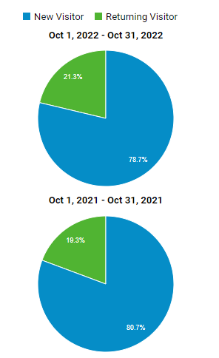
New Visitors V/S Returning Visitors
KPI 1: User Acqusition-Analysis and Recommendations
There has been a 2% increase in returning visitors when comparing October 2021 to October 2022, indicating improved customer retention year over year.
The number of new visitors has slightly decreased in terms of their share of total site traffic, with a decrease from 80.7% to 78.7%.
Despite the change in percentages, the absolute number of new visitors has increased slightly from 53,817 to 54,547. This suggests that while the site is attracting more visitors overall, the rate of growth for new visitors may be slowing.
The increase in returning visitors suggests that existing customers may have developed stronger loyalty to the brand or that post-purchase engagement strategies are effective.

Slide 6
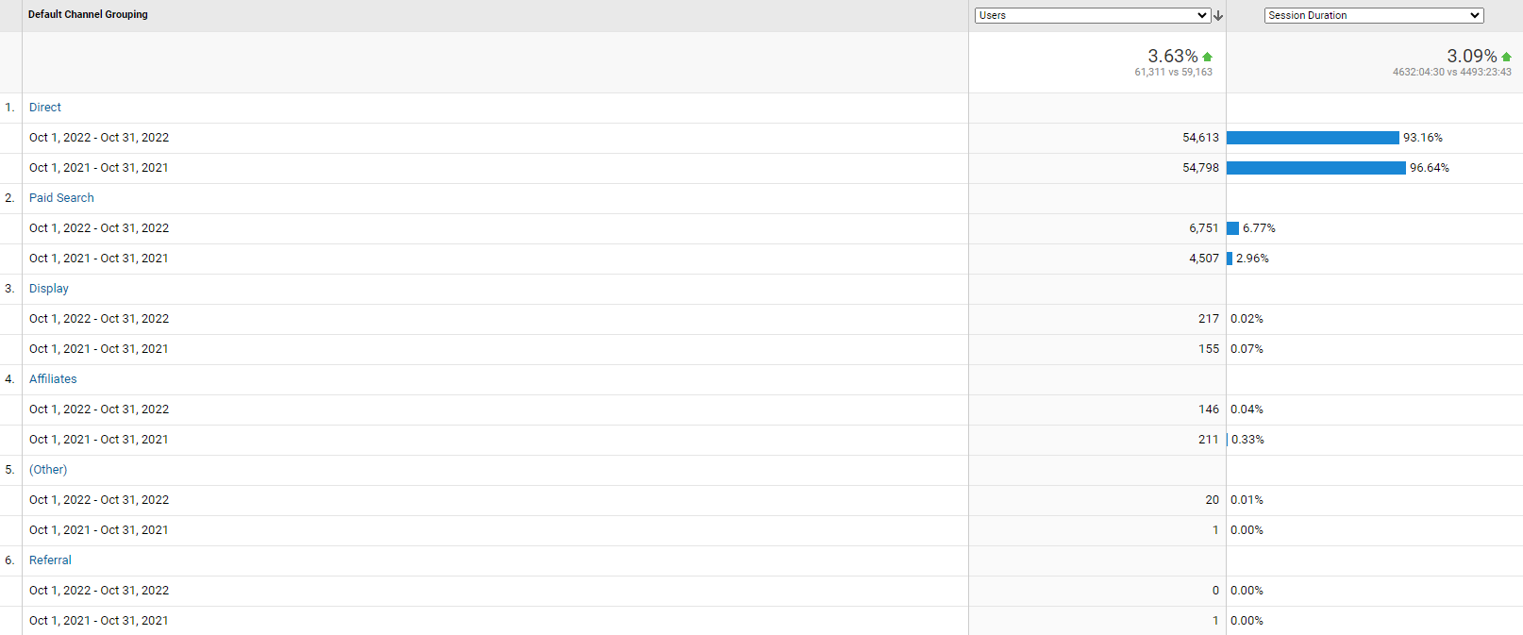
Users by Channels and Session Duration

Slide 7
Observations
There's a marginal decrease in the number of users coming from direct searches in 2022 compared to 2021.
Users from direct search spent less time on the site in 2022 with a session duration percentage of 93.16% compared to 96.64% in 2021
There was a significant increase in the number of users coming from Google's paid search (CPC) in 2022 compared to 2021.
The session duration for users from Google/CPC more than doubled from 2.96% in 2021 to 6.50% in 2022, indicating higher engagement from paid search traffic this year.
The decrease in session duration for direct traffic, despite a slight drop in user numbers, might suggest that users are finding what they need more quickly. This could be due to better site navigation or a change in user intent, possibly influenced by more targeted marketing or clearer branding.
The reduction in direct traffic session duration could also imply that repeat customers are becoming more efficient in their shopping habits, indicating a maturing customer base that is familiar with the platform.

Slide 8
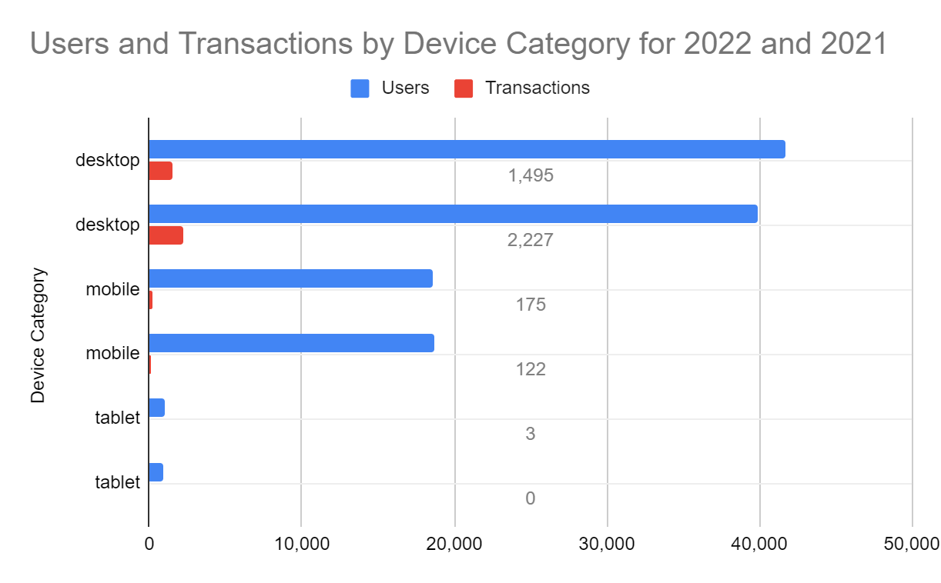
Users and Transactions by Device Category
The desktop remains the primary device for both users visiting the site and completing transactions, indicating that desktop optimization should remain a priority.
While mobile users are fewer compared to desktop users, there is a presence of transactions from mobile devices, which highlights the importance of a mobile-friendly website.
Tablet users represent the smallest group and have the least number of transactions, suggesting that this platform might be the lowest priority in terms of optimization.

Slide 9
Recommendations for User Acquisition
Leverage Remarketing Campaigns: Given the increase in returning visitors, set up remarketing campaigns targeting users who have visited specific pages but did not convert, with personalized messaging and offers.
Streamline Mobile Checkout: Implement a simplified, secure mobile payment process with fewer steps and autofill options to reduce friction, which can improve conversion rates and enhance the overall mobile shopping experience
Social Media and Community Engagement: Increase efforts on social media to build community and drive both new and returning visitors. Engaging content and community discussions can enhance brand loyalty and encourage repeat visits.
Partnerships and Collaborations: Collaborate with influencers or brands that share a similar audience to tap into their followers and drive traffic to the site. Ensure the collaborations are authentic and offer value to both user bases.

Slide 10
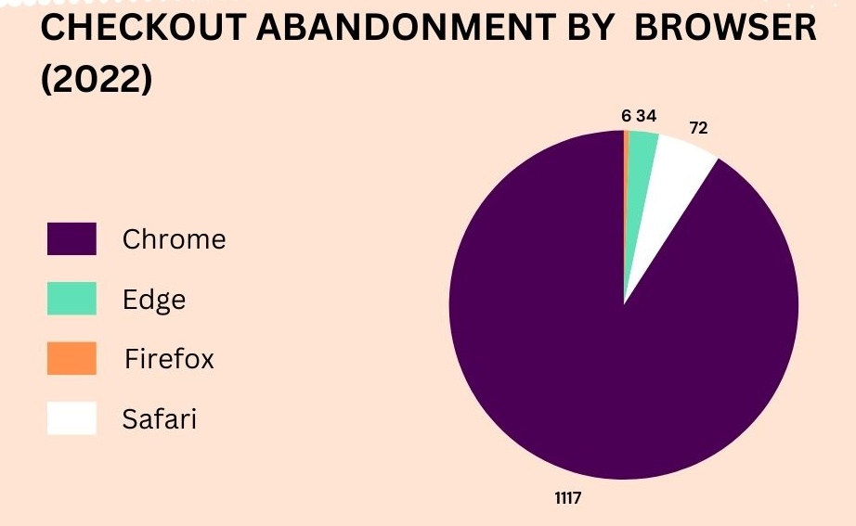

KPI 2:-Checkout Abandonment Rate by Browser
Our analysis reveals that Chrome users exhibit the highest rate of checkout abandonment, followed by those using Safari. Although the rate for Edge users is comparatively lower, there is still considerable opportunity for optimization in this area.

Slide 11
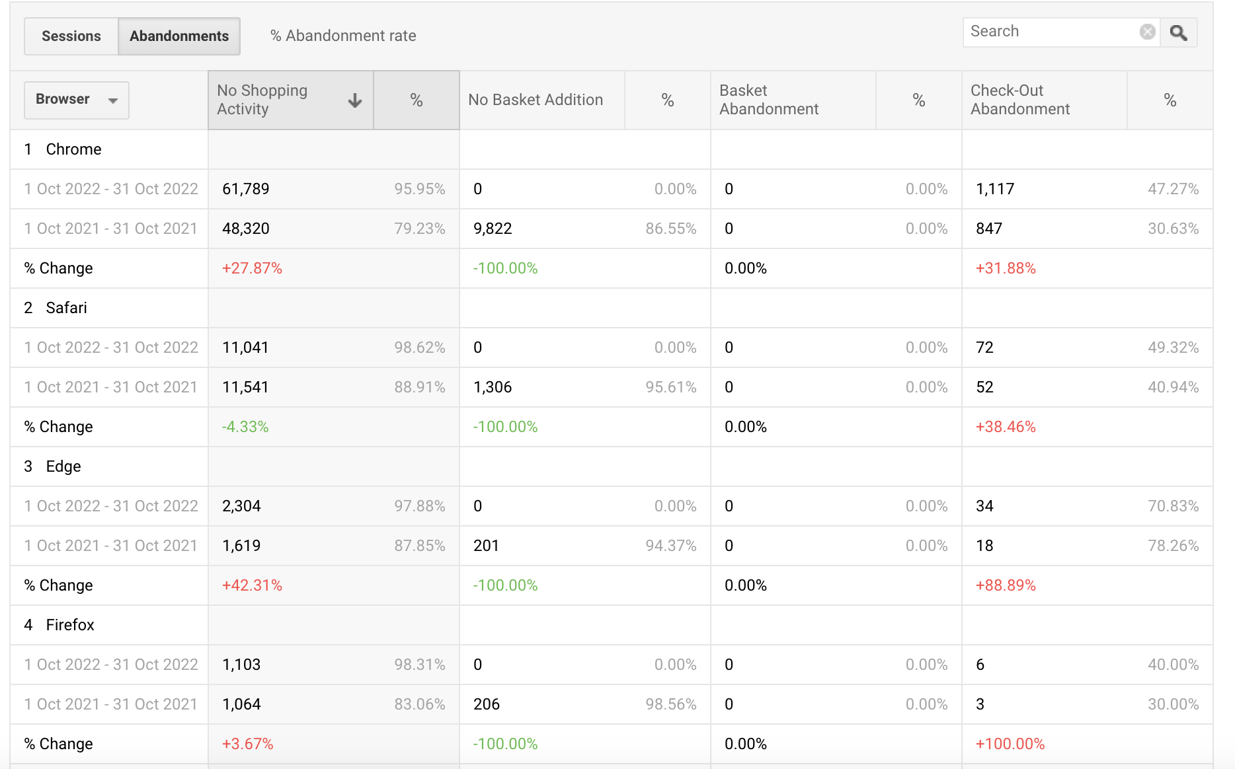

Slide 12
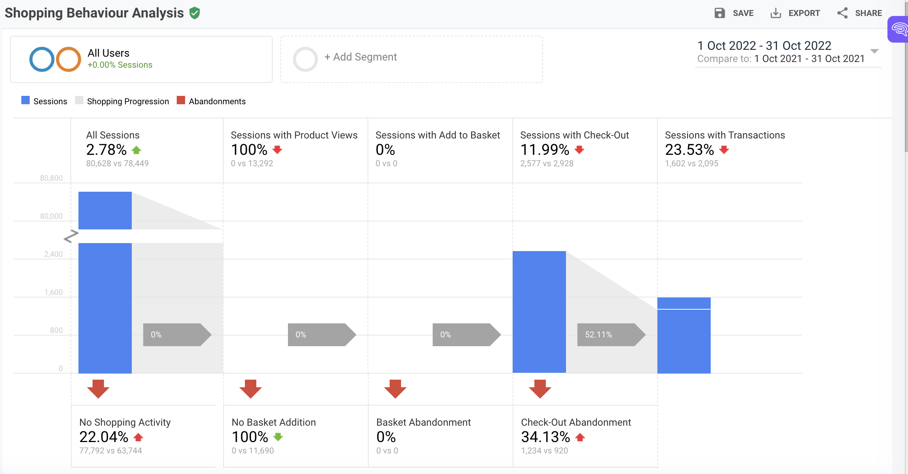

Slide 13
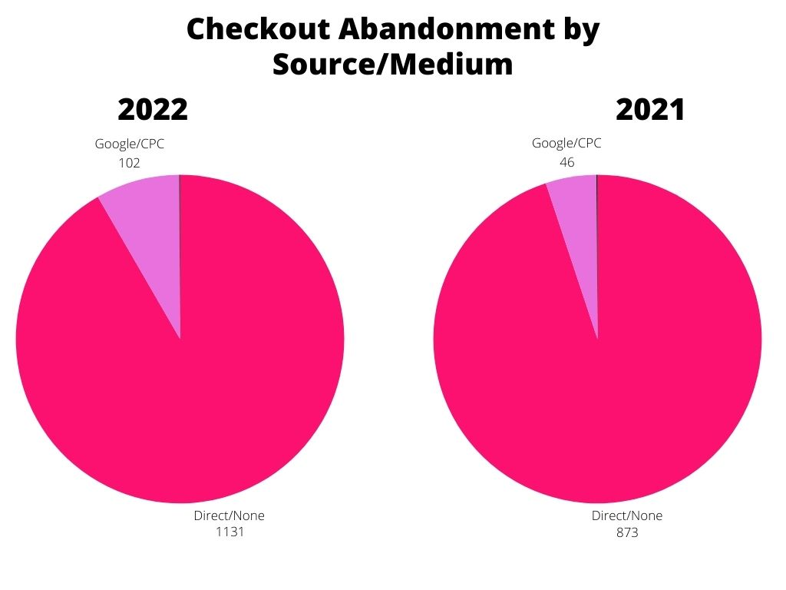
Source/ Medium
The analysis suggests that the channels labeled "Direct or None" and "Google or CPC" experience elevated levels of checkout abandonment when compared to "Bing or CPC" and "Partners or Affiliate" sources.

Slide 14
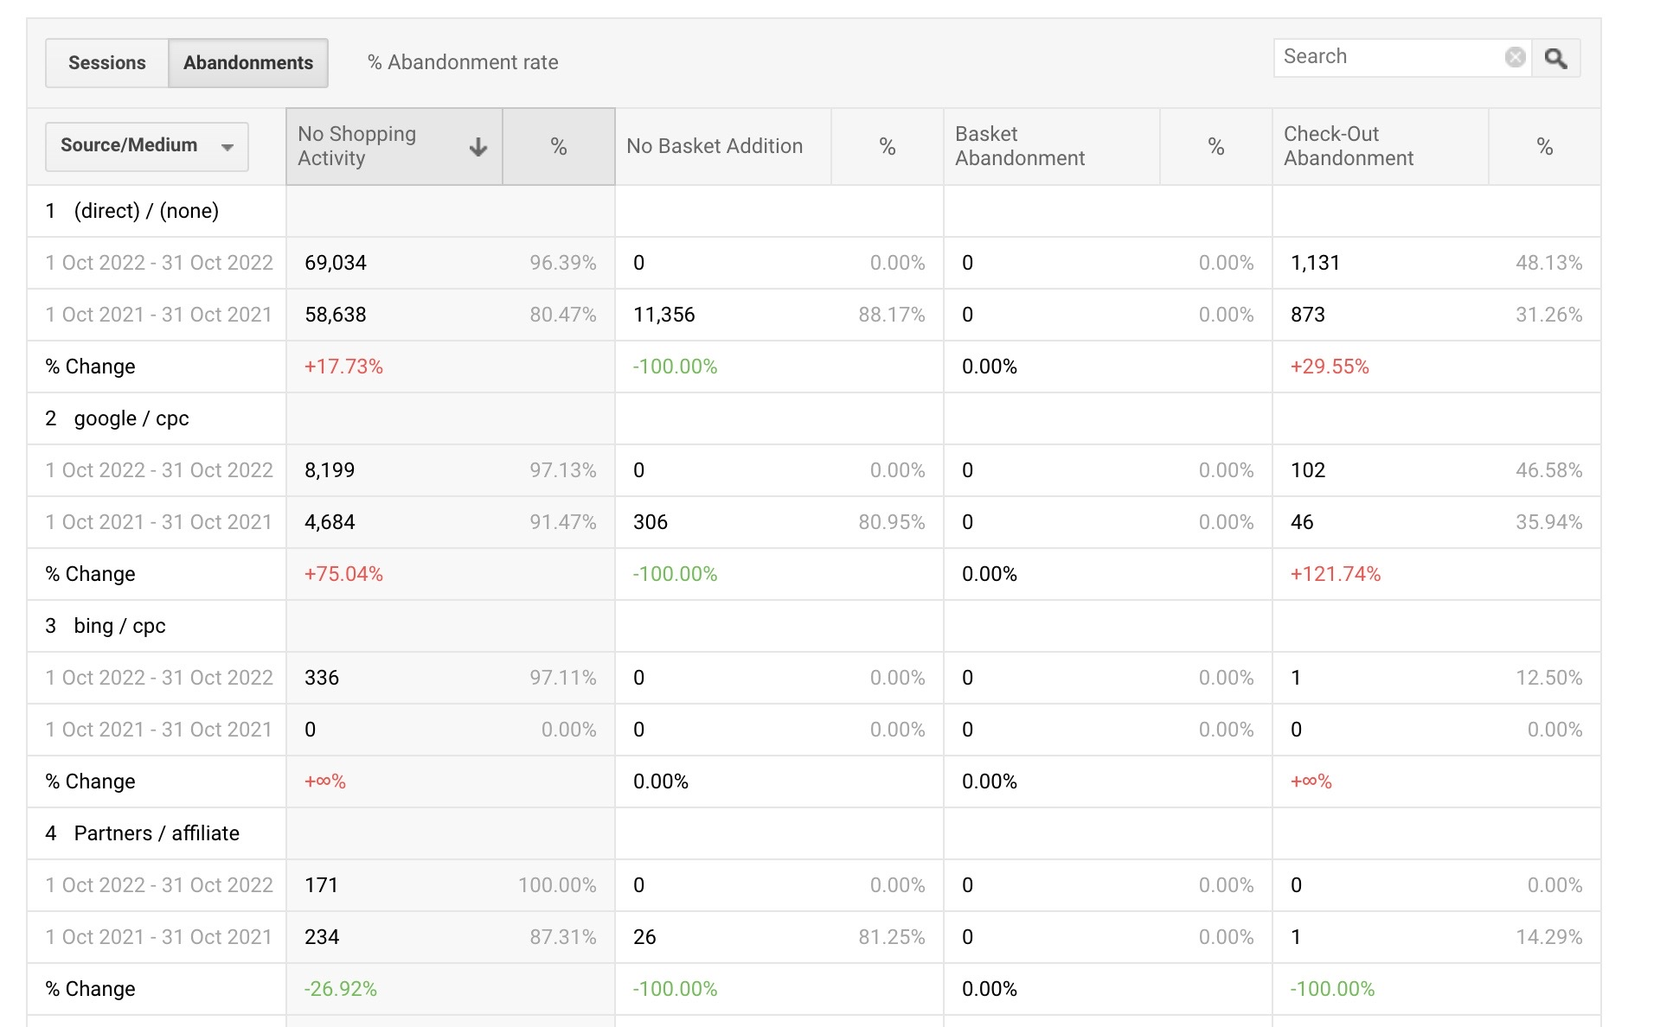

Slide 15
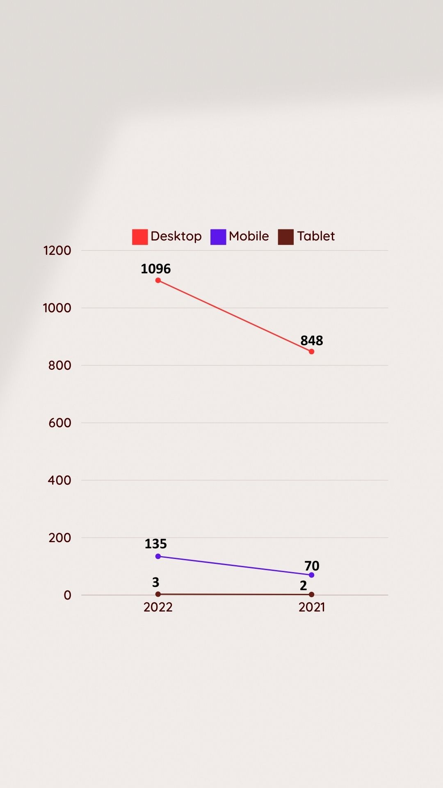
Device
Over the past two years, desktop users have consistently registered the highest number of checkouts.
While mobile follows closely, its performance, though lower, highlights a need for targeted improvements to decrease the abandonment rate.

Slide 16
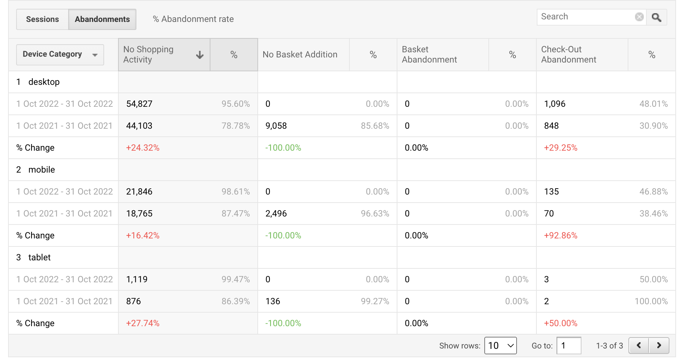

Slide 17
Recommendations for Abandonment Rate
Based on the observations outlined above, we propose the following recommendations:
1)Provide checkout options for guests.
2)Introduce a variety of payment gateways.
3)Display product thumbnails throughout the checkout process.
4)Enhance page load speeds to improve user experience.

Slide 18
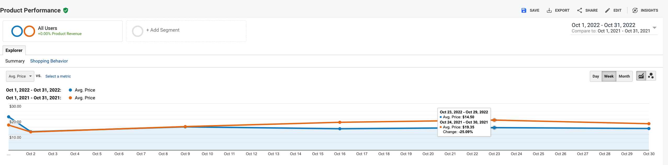
Overall Product Performance
Etsy has 5 product lines in which Craft Supplies , Jewelry comprise of 80% of the total product line where we wish to shift our focus.
We also observe that the average price of the products has decreased by 25.09% from $19.35 to 14.50
We notice that the new year see the two pre-existing SKU has dominated the product shares.
Craft Supplies
Others

Slide 19
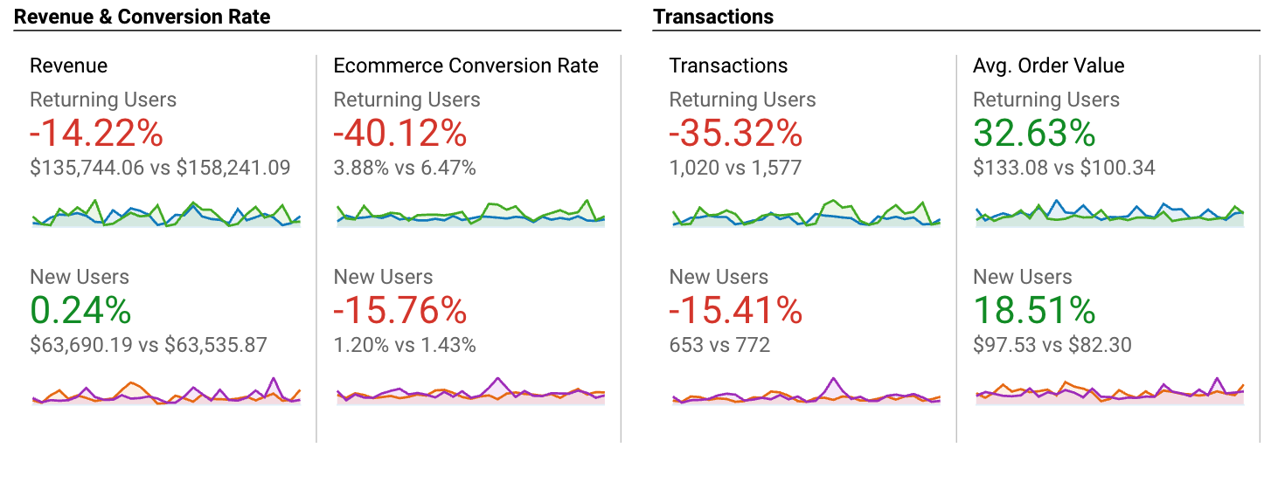
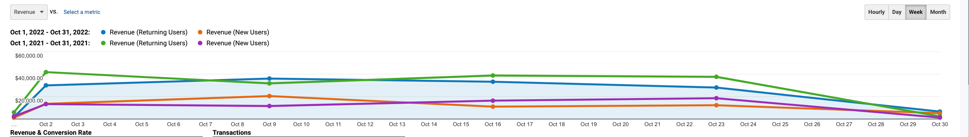
Slump in Conversion Rates
The data suggests a concerning trend of declining conversion rates and transaction volumes for both returning and new users. However, there are positive signs in the form of increased average order values for both user segments

Slide 20
Overall Revenue vs Transactions
We notice that the revenue has slumped from $221776 to $199434(-10.07%) since the past year whereas ,
The number of transactions has also dipped from 2349 to 1673(-28.8%)

Slide 21
Recomendations for Revenue Boost
Improve customer retention strategies:
The significant drop in revenue (-10.07%), conversion rate, and transactions (-28.8%) for returning users is a major concern. Implement targeted loyalty programs, personalized promotions, and re-engagement campaigns to retain existing customers and incentivize repeat purchases.
Leverage the increase in average order value:
Leverage the increase in average order value: Both returning and new users have shown an increase in average order value (32.63% and 18.51%, respectively). Capitalize on this trend by implementing strategies such as upselling, cross-selling, bundled product offerings, and targeted promotions to encourage larger order sizes and higher spending per transaction.
Optimize user acquisition and onboarding:
While revenue from new users has slightly increased ,the decreases in conversion rate and transactions suggest room for improvement in acquiring and converting new customers. Review and optimize user acquisition channels, campaigns, and the onboarding to attract and convert more high-quality new users effectively.

